Slide 1
Group 8
Open Ended Data Analysis Assignment
Notes:
Introduce the group

Slide 2
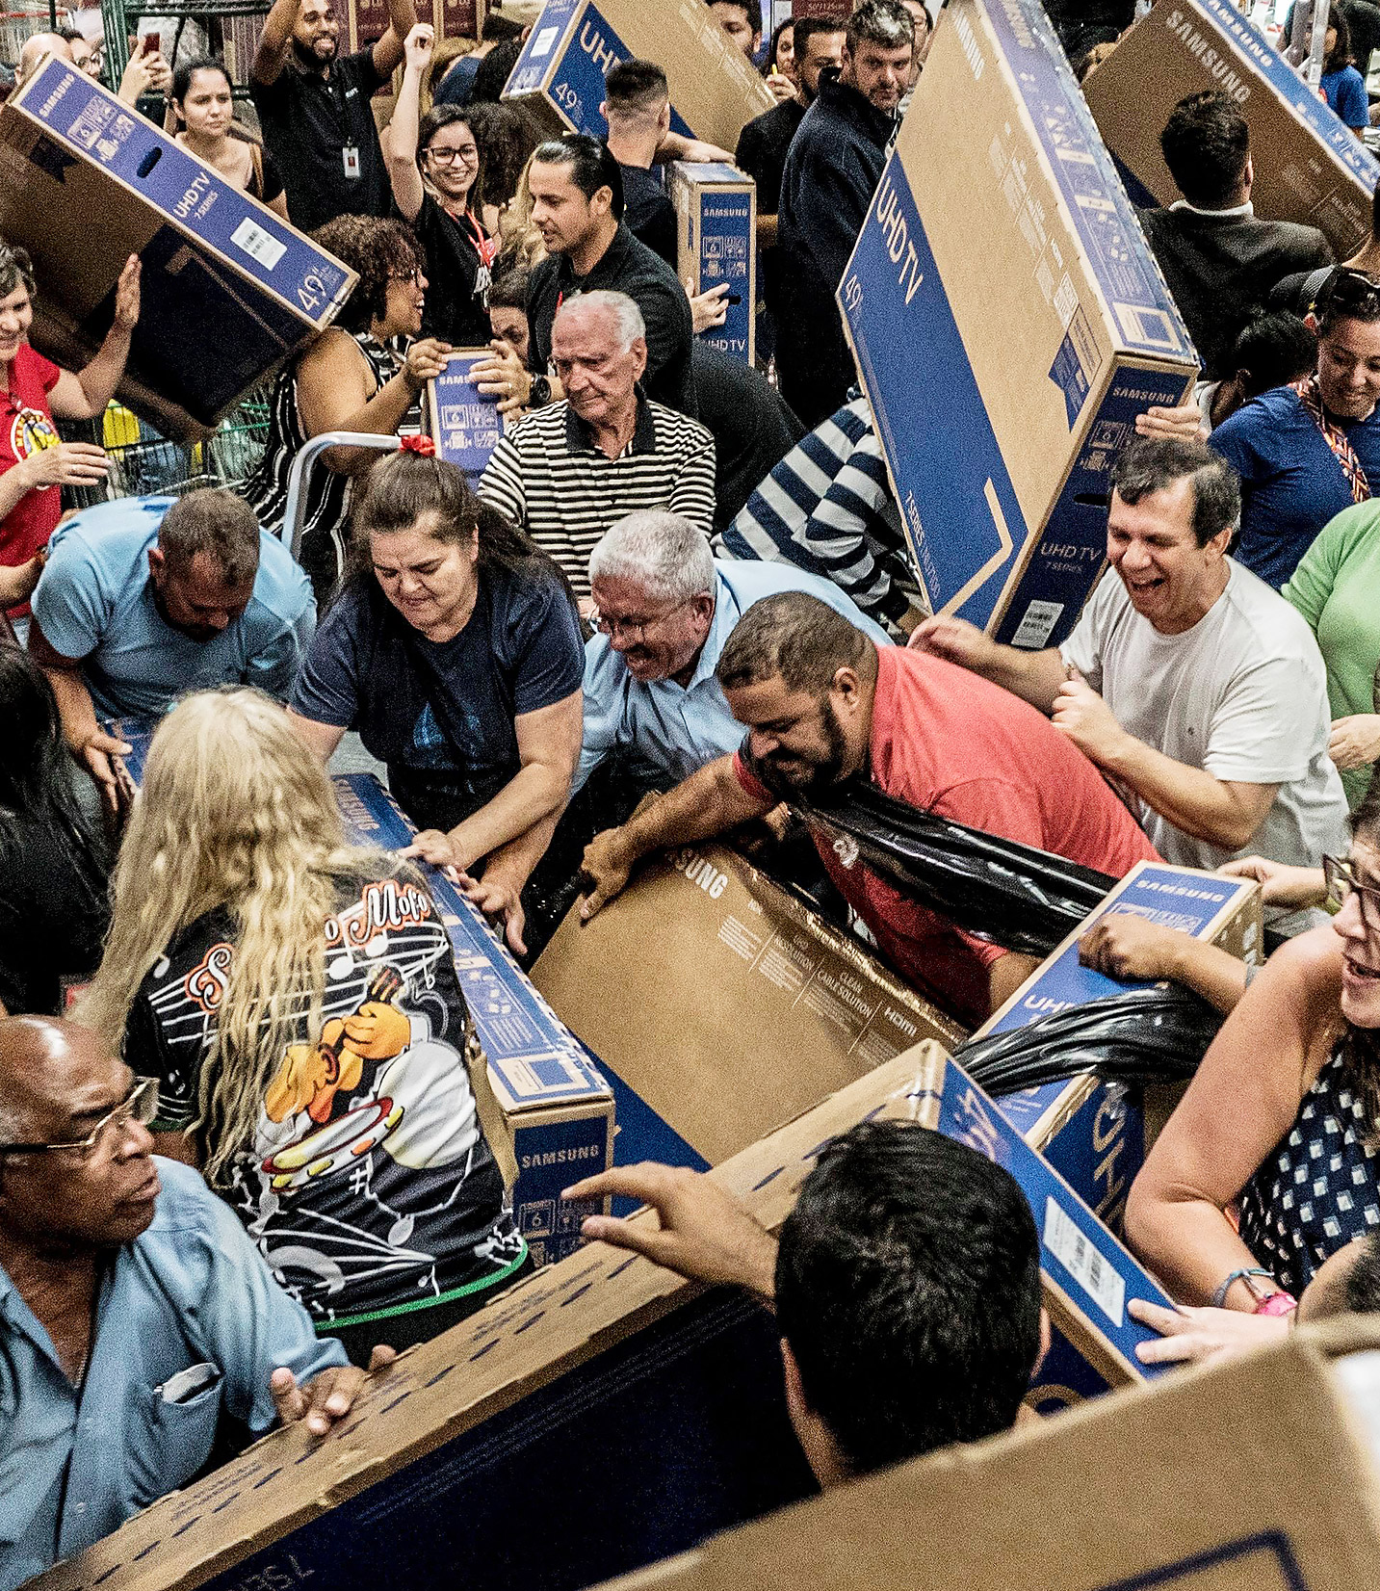
Black Friday
Notes:
Explain what black friday is, sales etc.

Slide 3
The data
https://www.kaggle.com/mehdidag/black-friday
Categorical and Numerical Variables
Categorical : 1. Gender 2. Age 3. Occupation 4. City Category 5. Stability 6. Marital Status
Numerical : 1. Purchase
Notes:
The types of variables, categorical vs numerical, how we worked through it

Slide 4

What comes to mind?
Notes:
Ask the questions here, what we aim to find out, how we are looking at it, etc
Questions : How does each category affect profit Predictions, predicting categories of products and jobs Noting that not only number of customers matters but also the amount that they spend

Slide 5
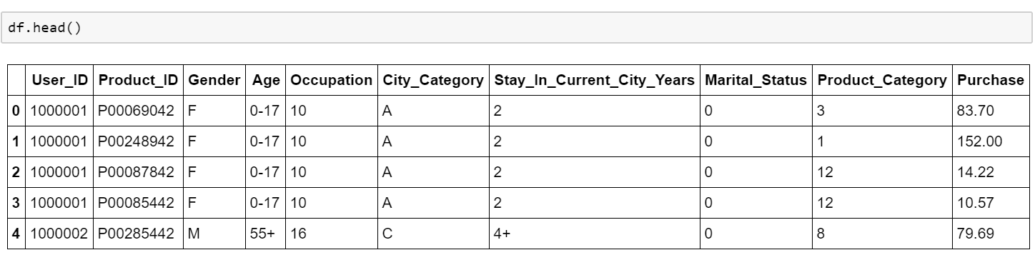
What does the data look like?

Slide 6
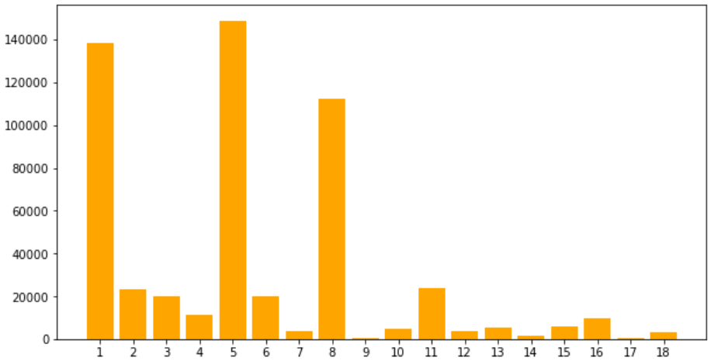
Product Categories

Slide 7
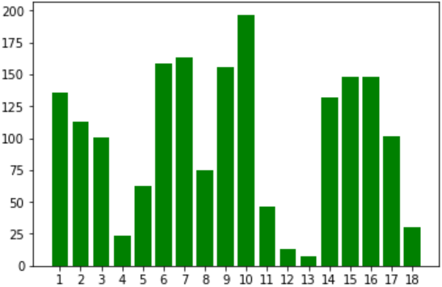
Mean Costs

Slide 8
Looking at the categories

Slide 9
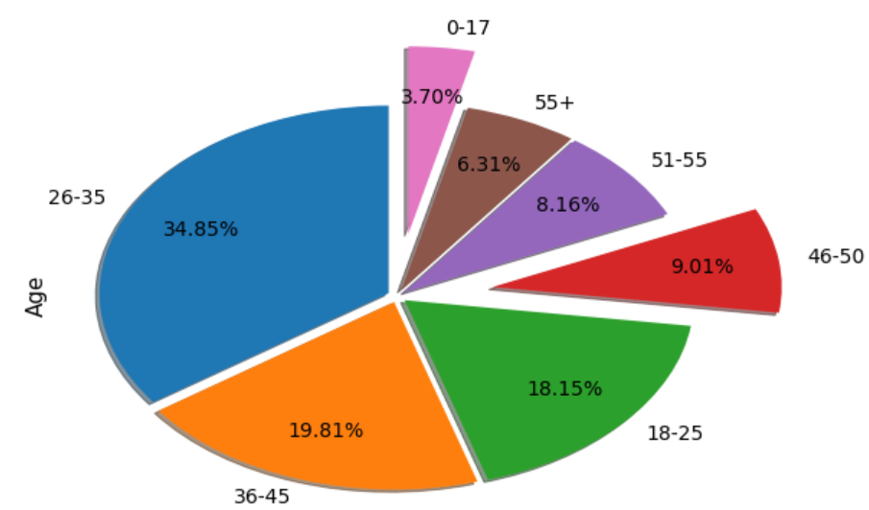
Age distribution in the population

Slide 10
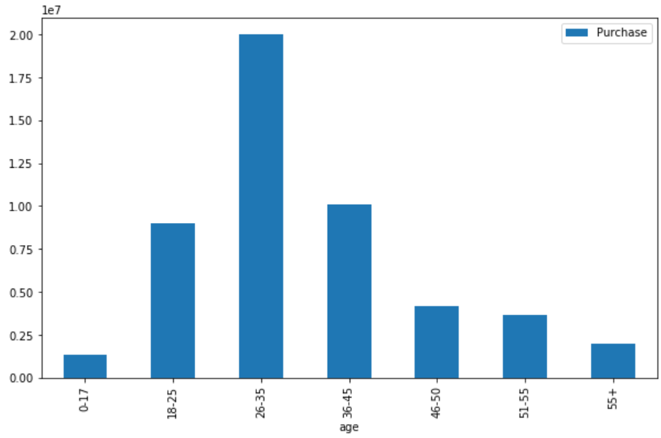
The Purchases according to age
So, our first conclusion!

Slide 11
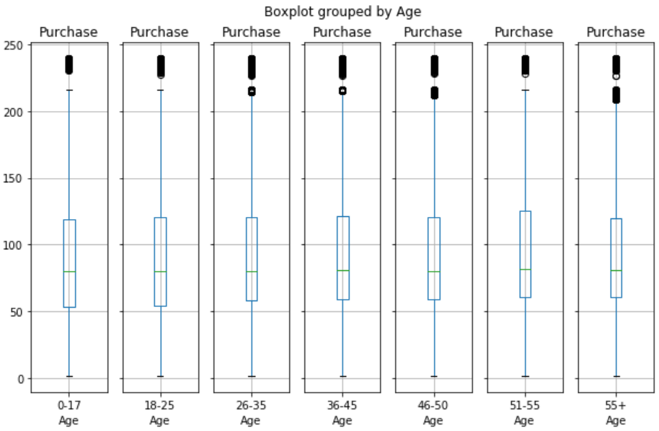

Slide 12
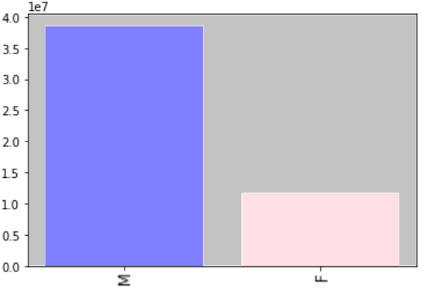
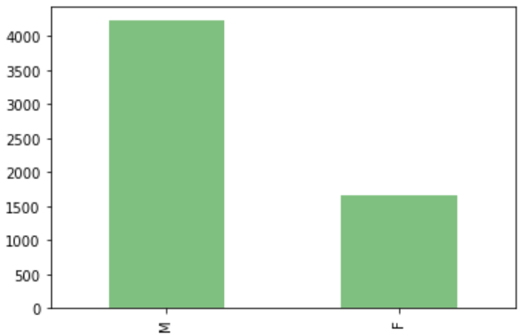
Gender:

Slide 13
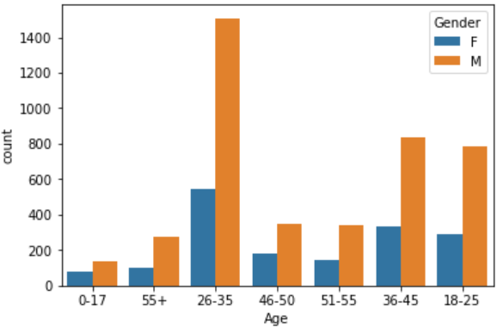

Slide 14
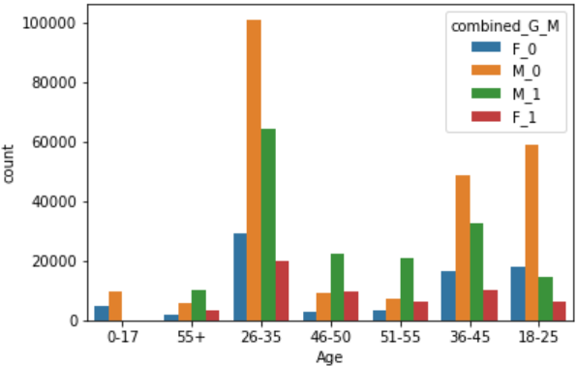

Slide 15
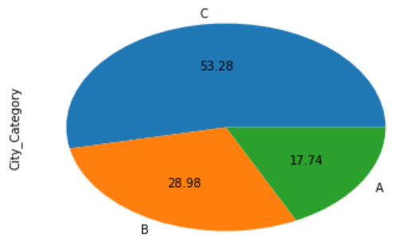
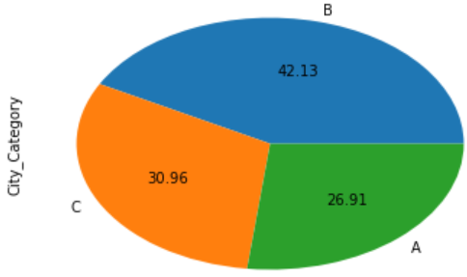
By population:
City Category
By no. of products:

Slide 16
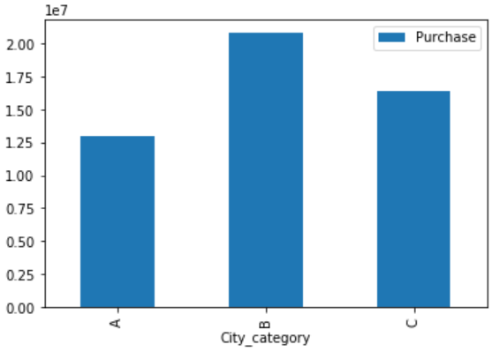
Sales according to city category :

Slide 17
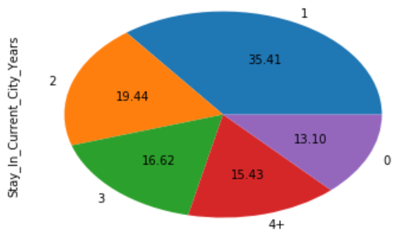
Stability

Slide 18
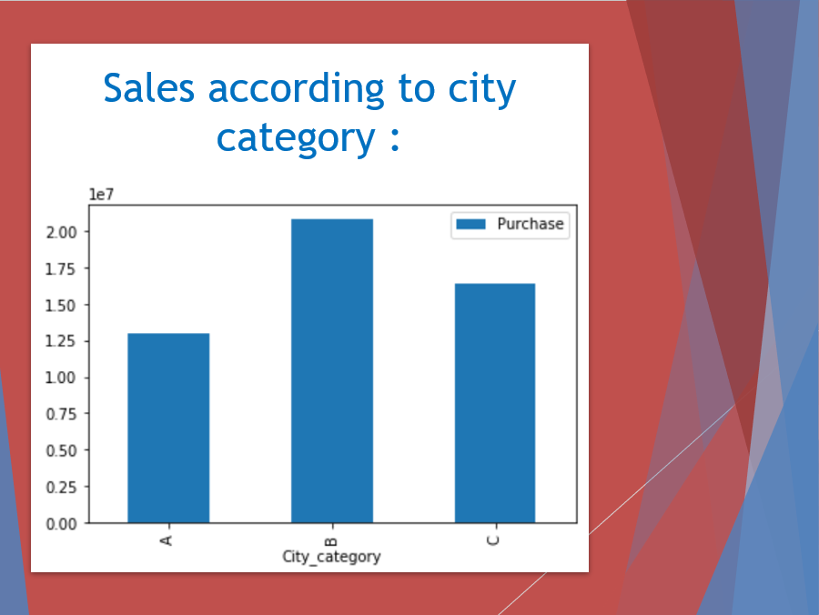
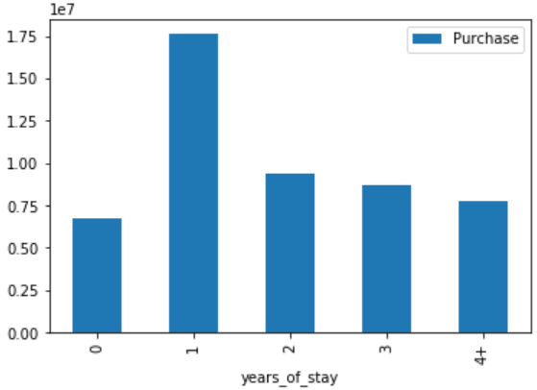
Sales according to years of stay :

Slide 19
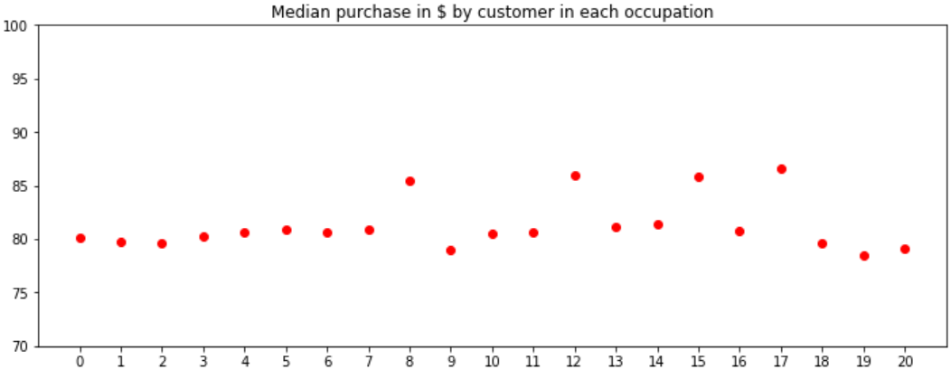
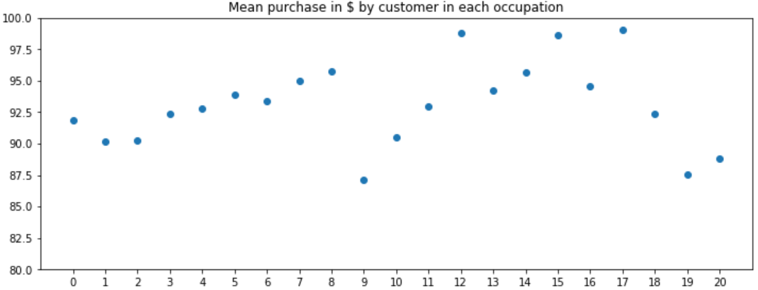
Occupation

Slide 20
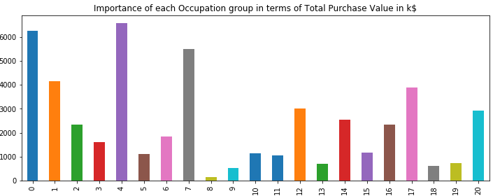

Slide 21
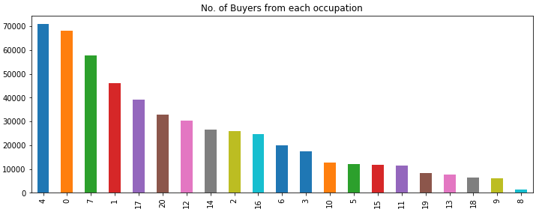

Slide 23
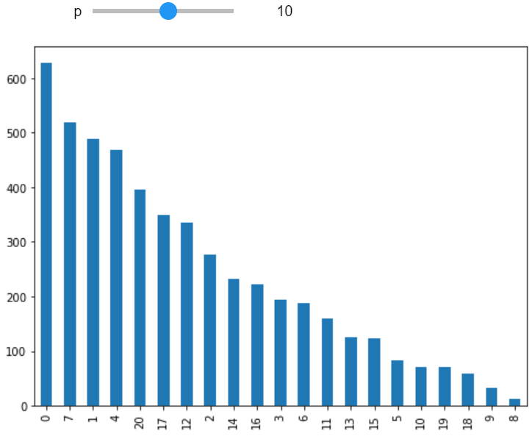
Buyers vs Occupation for product category 10

Slide 24

Conclusions

Slide 25
Libraries used and learning opportunities
matplotlib
pandas
scipy.stats
seaborn

Slide 26
The Team
Arjun Gupta – 180010012
Yash Chauhan - 180010019
Priyansh Patil – 180010044
Samar Jain – 180010052
Swarit Sood – 180010056

Slide 27


